Slide 1

Enterprise Software Development

Slide 2
There shall be light: Control LED with your Raspberry Pi and UWP
Jernej Kavka, SSW, Australia

Slide 3
Why UWP?
C# + XAML
On all Windows 10 platforms
Desktop, Tablet, Phone, Xbox, IoT, HoloLens, etc.
One app, multiple platforms

Slide 4
Parts of demo
Step 1
UWP app with virtual light
Step 2
Control 1 LED light with IoT extension
Step 3
Control X LED lights
Bonus step
Control LED lights with an external service

Slide 5
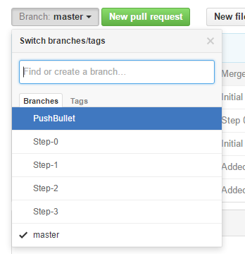
GitHub
https://github.com/jernejk/IotHackathonLedDemo
Step-by-step branches

Slide 6


DEMO - Step 1
UWP app with 1 virtual light

Slide 7
Step 2
First we need to talk about the basics

Slide 8
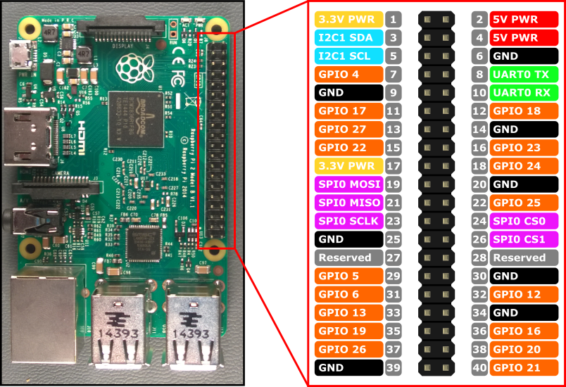
Raspberry Pi 2 pins

Slide 9
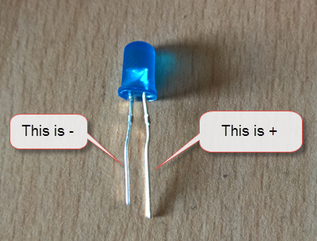
About LED lights
Long leg is +, short one is –
Don’t use LED directly on RPi
Use resistors (demo uses 4.7k ohm)

Slide 10
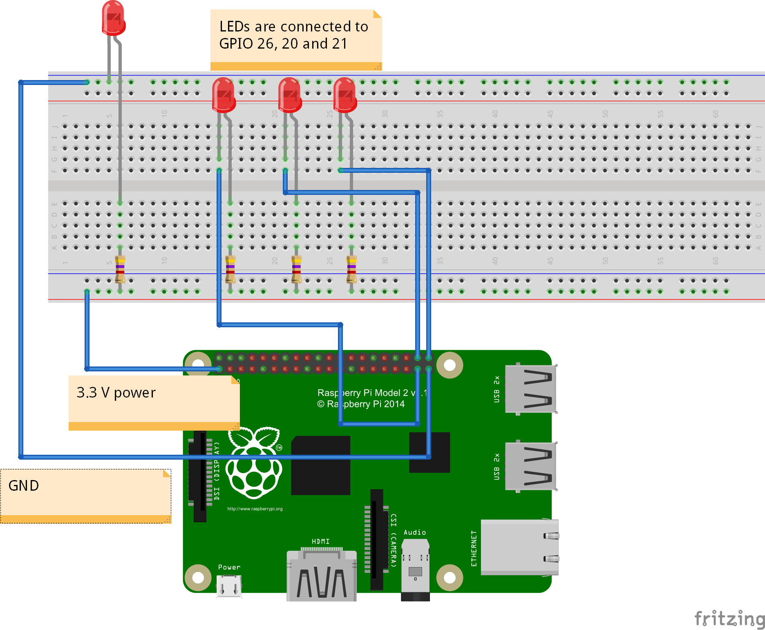
Demo circuit
Pin 1 - 3.3 V power
Pin 39 - GND
Pin 40 – GPIO 21
Pin 38 – GPIO 20
Pin 37 – GPIO 26

Slide 11
IoT extensions
Use this extension for IoT specific features
Add references… -> Universal Windows -> Extensions
Windows IoT Extensions for the UWP
Allows you to access Raspberry Pi pins
GpioController and GpioPin
Some features are not available on all platforms
Use ApiInformation.IsTypePresent(fullTypeNameWithNamespaces) to detect features

Slide 12
DEMO - Step 2
Control 1 LED light with IoT extension

Slide 13
DEMO - Step 3
Control X LED lights

Slide 14
DEMO – Bonus step
Control LED lights with an external service

Slide 15
Sources
https://ms-iot.github.io/content/en-US/win10/samples/KitBlinky.htm
http://fritzing.org/

Slide 16
Thank you! jernejkavka@ssw.com.au www.ssw.com.au Sydney | Melbourne | Brisbane | Adelaide

Slide 17
Find me on Slideshare!
http://www.slideshare.net/SSWconsulting

